Slide 1

Price Models - 1
A framework for modeling complex prices

Slide 2

What are Price Models?
A price model represents what the Price of a product is since a particular date, in a specific currency and using a specific pricing strategy
A strategy tells the system how pricing calculation to use
Should past usage be used when determining a price

Slide 3
Flashback - era of Drools..
rule "Lemon and Coffee discount"
when
$order : OrderDTO( ) # any order
OrderLineDTO( itemId == 2) from $order.lines # Lemonade
OrderLineDTO( itemId == 3) from $order.lines # Coffee
# only if the discount is not already there
# otherwise an infinite loop happens (the no-loop attribute would
# have the same effect)
not ( OrderLineDTO( itemId == 14) from $order.lines )
then
OrderLineBL.addItem($order, 14, false); # 10% discount
update($order);
end

Slide 4
There are several pricing calculations, or strategies that can be selected. A price is calculated using a selected strategy. Past usage is queried by the system if the strategy requires it.
Strategy
Requires Usage?
Get Past Usage
Calculate a price
Metered
Graduated
Flat
Rate Card
And more…
Skip usage query if
not required.

Slide 5
Why use Price Models?
Model complex prices with a simple configuration
Customers can build plans around items with complex prices without needing to write rules or java code
New strategies for pricing can be easily added with little coding

Slide 6
Flexibility
Customer requirements for pricing can be met by adding new pricing strategies.
Strategies are added to the system by creating new classes that implement the pricing strategy interface.
The new price strategy can be programmed with its own logic
there is no need for extra configuration data or database entries

Slide 7
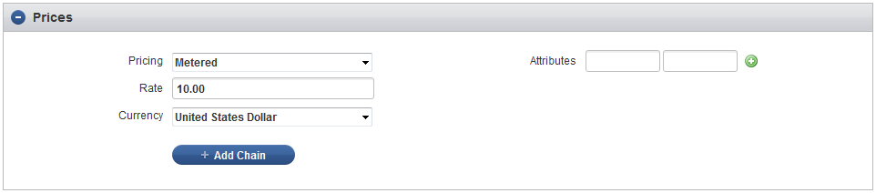
How does it work?
The pricing strategy can be set for a product.
When the product is added to an order the price is calculated using the selected strategy.

Slide 8
Flat
Metered
Each Price strategy is a stand-alone piece of code. A strategy encompasses all the logic needed to calculate a price which makes them easy to write and easy to test.

Slide 9
Quantity Add-on
Graduated
Some price models can be chained
A chain of price modELs produces a different result than what a single entry would do on its own

Slide 10
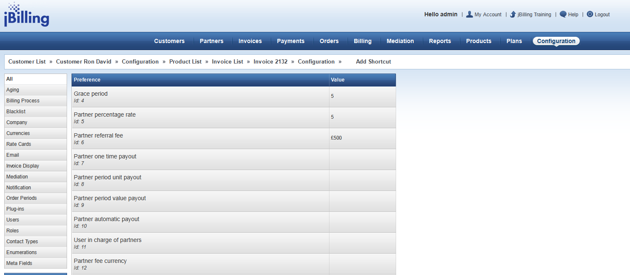
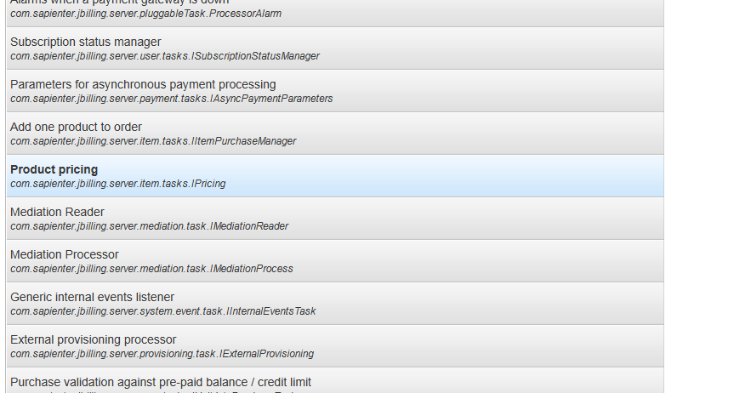
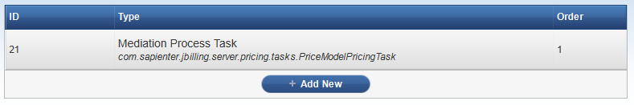
Configuring jBilling
1
A price model can only be used with the price model pricing plugin. This plug-in is responsible for running the price calculation, querying usage and producing the final price for the order.
3
2

Slide 11
The pricing plug-in can be configured to change how prices are calculated and usage is queried through parameters:
Usage_type = ‘USER’ or ‘PRICE_HOLDER’
Prices can be inherited from a parent account. Get usage from the user owning the order or the user that holds the price?
Include_sub_account_usage = true or false
do we include usage from the customers sub-account?

Slide 12
How to create one
You can add a new pricing strategy by:
Add a new strategy class
List the new strategy in the price model strategy enum
Add a grails UI template to display in the application

Slide 13
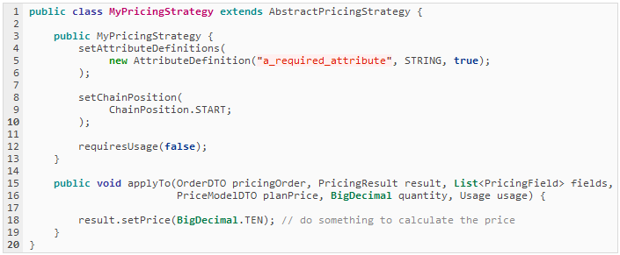
Step 1: Add a strategy class
A new strategy should extend from AbstractPricingStrategy
applyTo() should calculate the price and set PriceResult price

Slide 14
Attribute Definitions:
Your price strategy can define required attributes as "attribute definitions". The attribute definition specifies the name of the attribute, the data-type and if it's required.
Chain Position:
The chain position defines where this particular price strategy can appear in a chain. Some price strategies (such as percentage) should only be used at the end of a chain, others only at the start.
Requires Usage:
If set to true, the past "Usage" for the product being purchased will be counted and passed into the applyTo() method.

Slide 15
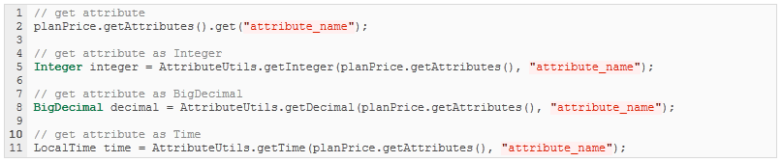
Attribute values are passed into the apply to method as part of the original price model object.
You can use the attribute utils class to parse attributes as a specific data type or just access them.

Slide 16
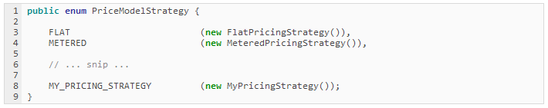
Step 2: Update the strategy enum
Add a new entry to the PriceModelStrategy enum, this gives your strategy a name and makes it usable in a Price Model

Slide 17
Step 3: UI Template
Templates live in grails-app/view/priceModel/strategy/
The enum name is converted to ‘camelCase’ and used for determining the name of the UI template
PriceModelStrategy.METERED
PriceModelStrategy.MY_PRICING_STRATEGY
_metered.gsp
_myPricingStrategy.gsp

Slide 18
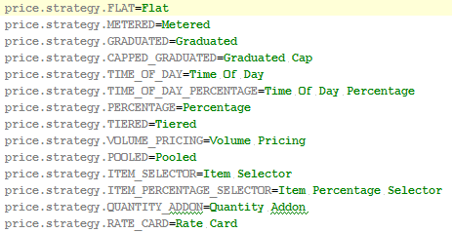
i18n
In the messages.properties file look for the line:
price.strategy.
There add a new entry following this pattern:
price.strategy.MY_PRICING_STRATEGY
So it’s the same name you used in the enum.

Slide 19
Exercise
Design a new Pricing Strategy called as ‘MinMaxPricingStrategy’ This Strategy takes 2 attributes: min, max These attributes should be decimal values for minimum and maximum applicable price for a product This is a chained pricing strategy having chain positions based on your own discretion Price Resolution should be based on following rules: No matter what price is resolved, it cannot exceed the max price No matter what price is resolved, it should not be lower than the min price *** Shorter the code, better rating

